Slide 1
The Battle of Neighborhoods Location Analysis and Recommendation

Slide 2
Introduction
The project focuses to help people who newly move into a city .
It works to find areas according to their choices so that it becomes easier to find a place to lookup in bigger cities.

Slide 3
Problem Statement
A person wants to find a place for his stay in New York City. The person loves Asian food and hence
wants to find a location where it is available. Using Foresquare API, the areas of the city are analyzed
and explored to find an area with maximum number of Asian Restaurants. Furthermore, the avaibility
of Market Places, Health Care Stores, Shopping Malls ,Salons etc are also to taken into consideration
while finding the best location. Finally a list of all venues in the selected neighborhood is given and
plotted on the map. A list of other requirements to be considered for the above problem are:
Essential Requirements:
Bank
Bakery
Pharmacy
Market/Store/Shop
Salon
Health and Beauty Service
Gym
Park
Spa
Non-Essential Requirements:
Tea Shop
Tea Room

Slide 4
Objectives
To find out the Asian Restaurants in New York City
To find the Borough with maximum Asian Restaurants
To explore the neighborhoods for highest number of Asian Restaurants for the above result of the Borough
To explore the above selected neighborhoods for the other requirements as per the list in the above problem statement.
To find the neighborhood which fulfills most of the essential requirements
To explore the neighborhood further and give a list of all venues in the area
Cluster all the venues and the necessary venues on a map
Based on the above findings,the most preferred area is suggested whose all venues are plotted as cluster on the map
Another neighborhood is suggested based on the next best suited area

Slide 5
Data
The dataset used consists of four columns-Borough, Neighborhoods, Latitude and Longitude.
There are 5 Boroughs in New York City.
A Borough is a town or district of administrative unit.

Slide 6
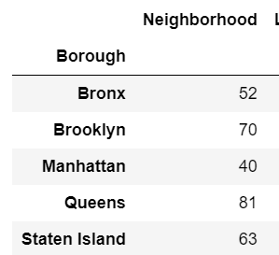
Understanding the Data
There are 306 rows and 4 columns in the dataframe.
Count of neighborhoods in each Borough:

Slide 7
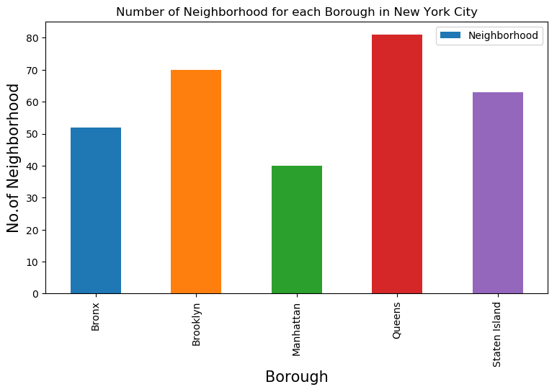
Plot of Boroughs and Neighborhood count
From the data in previous slide

Slide 8
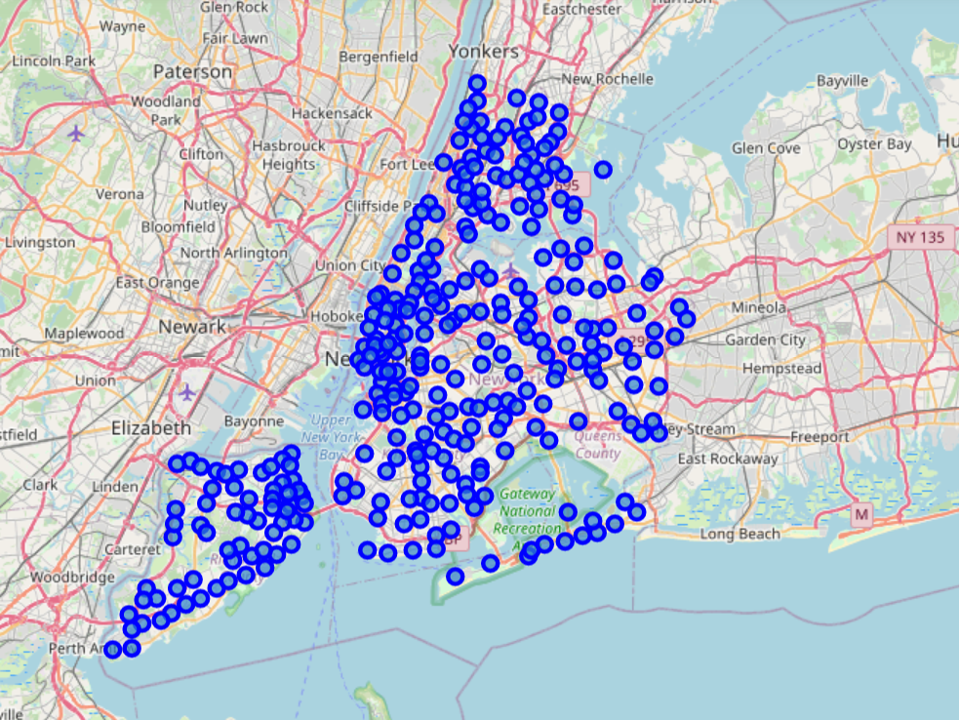
Clustering the Neighborhoods in New York City
Zoom start value=10

Slide 9
Foresquare API
Using Foresquare API,a list of Asian Restaurants in New York City is found.
The Borough with maximum Asian Restaurants is selected.
The neighborhoods in the Borough are analyzed and the ones with maximum Asian Restaurants
For each neighborhood, all the desired requirements are checked and their count is taken into consideration.
The neighborhood with the avaibility of most the requirements is selected and further analyzed for a list of all the venues in the area and cluster them onto a map.
Another cluster is made for the necessary requirements only.

Slide 10
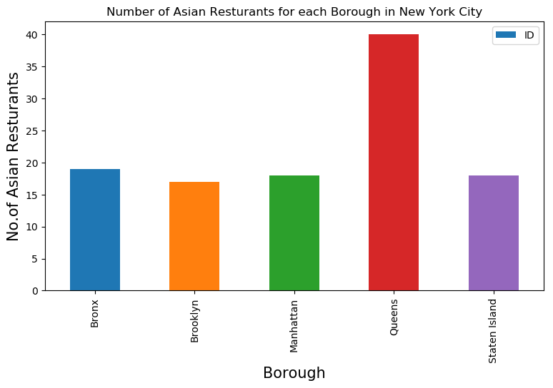
Asian Restaurant Count for each Borough
From the graph, it is evident that Queens has the maximum number of Asian Restaurants

Slide 11
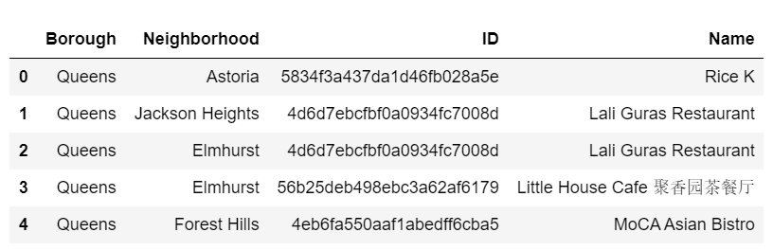
Exploring Queens Further
Top five values from the dataframe:

Slide 12
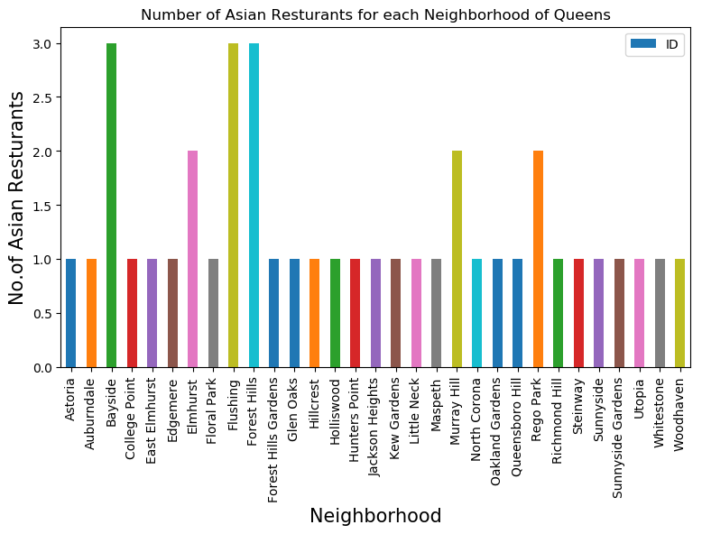
Plot of Neighborhoods of Queens and the count of Asian Restaurants
Bayside,Flushing and Forest Hills have equal and maximum Asian Restaurants.Further analyzing these neighborhoods.

Slide 13
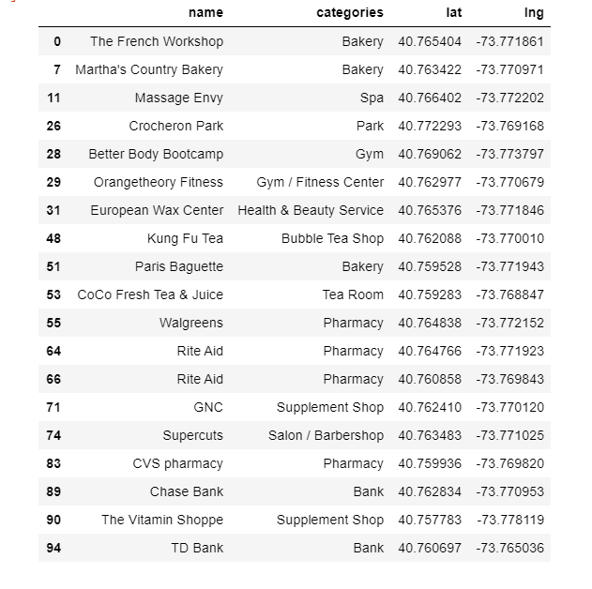
Exploring Bayside
The data with only the requirements as per problem statement:

Slide 14
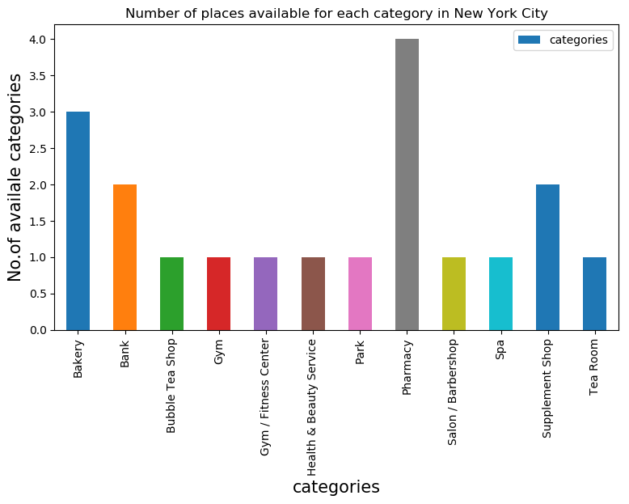
Bayside Data Graphical Analysis
The plot is between categories and count of categories for the selected requirements as in the data in the previous slide

Slide 15
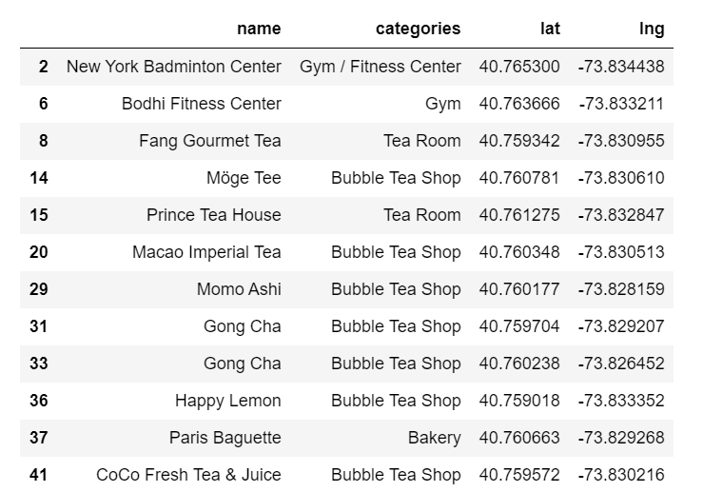
Exploring Flushing
A glimpse of the data with only the requirements as per problem statement:

Slide 16
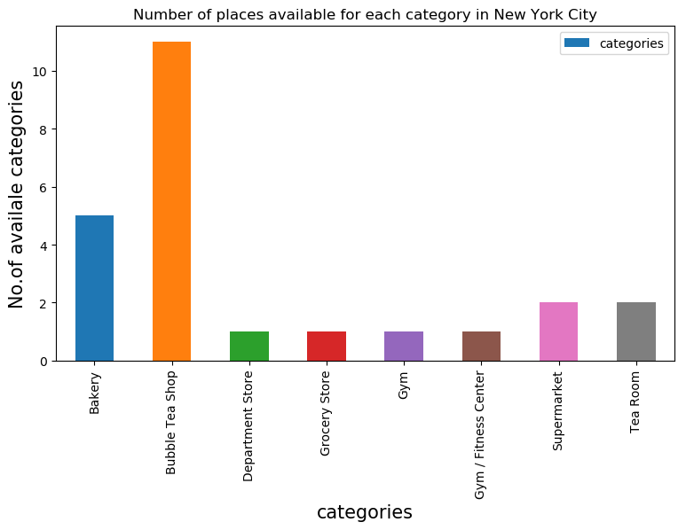
Flushing Data Graphical Analysis
The plot is between categories and count of categories for the selected requirements with reference to the data in the previous slide

Slide 17
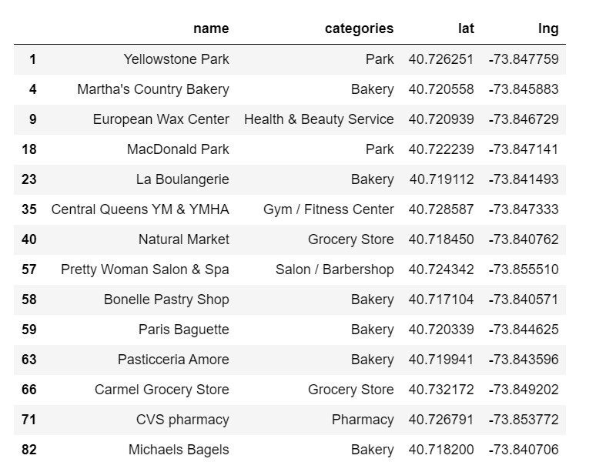
Exploring Forest Hills
A glimpse of the data with only the requirements as per problem statement:

Slide 18
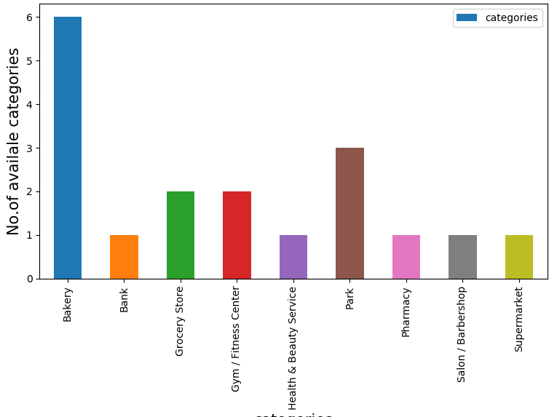
Forest Hills Data Graphical Analysis
The plot is between categories and count of categories for the selected requirements with reference to the data in the previous slide

Slide 19
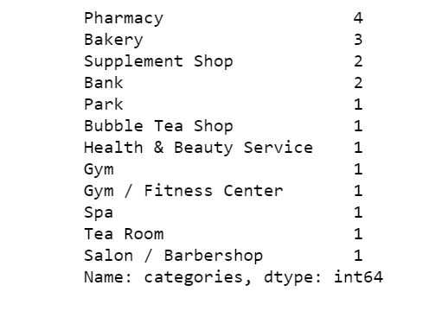
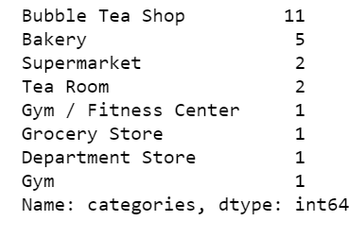
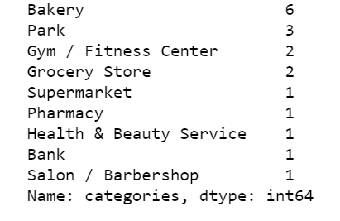
Graphical Analysis Results and Comparison
Flushing
Bayside
Forest Hills

Slide 20
Results
Best Suited Neighborhood Recommendation:
After the comparisons, the recommended
results are:
Forest Hills
Bayside

Slide 21
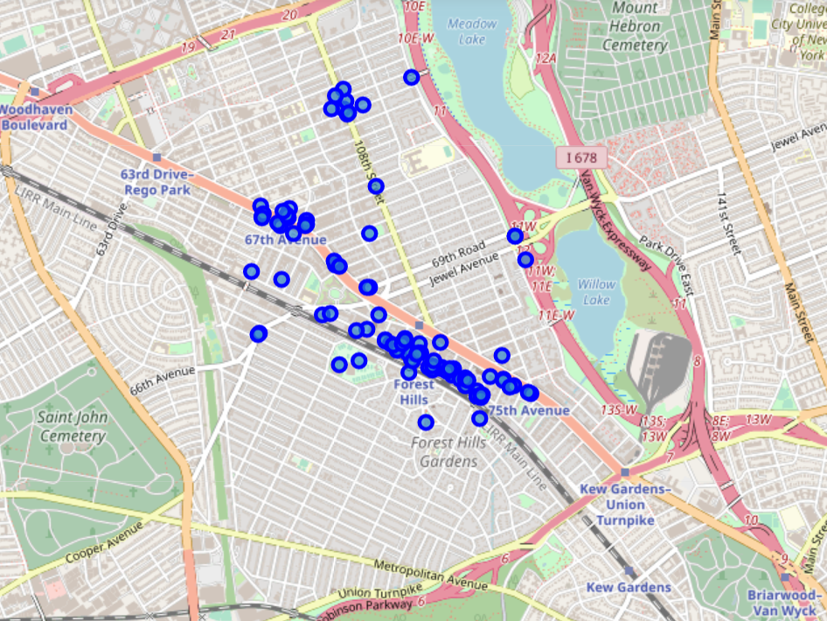
Clusters of all venues in Forest Hills
All the available venues found with Foresquare API for Forest Hills are clustered above

Slide 22
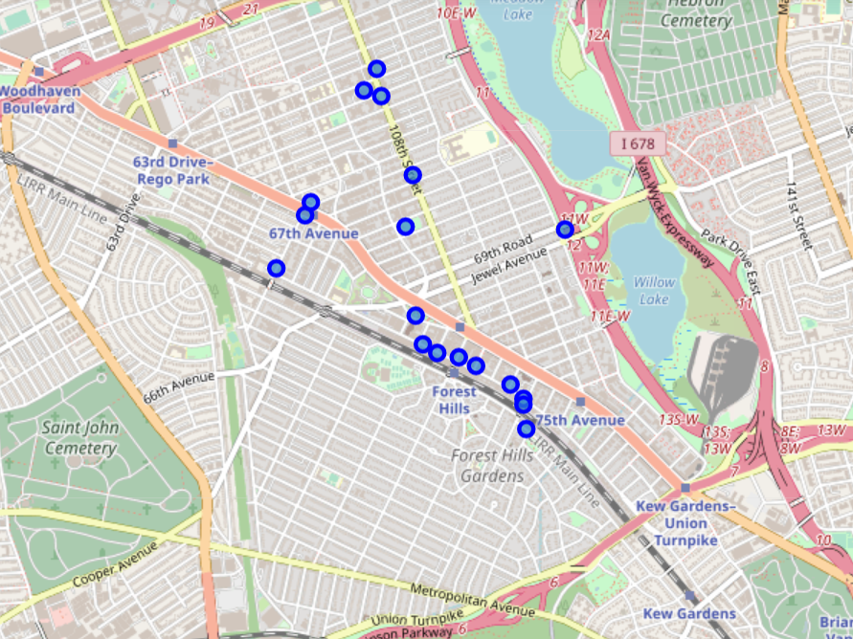
Clusters of only the required venues in Forest Hills
All the required venues as stated in the Problem Statement are plotted as clusters

